Slide 1
EU regulation on chemicals in tattoo inks under REACH: background and next steps
4th European Congress on Tattoo and Pigment Research (ECTP) 26-28 March, Bern
Giuseppina Luvarà
Policy Officer
EU Commission-DG Environment

Slide 2
Tattoo inks: current situation
Tattoo inks injected to create a tattoo or permanent make-up (PMU) – in the dermis or other parts of the body.
12% of European citizens have tattoos
prevalence in some age groups more than double
3-20% of the general population – PMU (or cosmetic tattoo)

Slide 3
Tattoo inks and studies
Tattoo inks comprised of colorants and auxiliary ingredients:
Colorants not developed for the purpose of injecting in the skin
Studies have reported:
Large number of mild cutaneous complaints related to tattoos
Small number of persistent cutaneous complications requiring medical treatment (including removal)
Small number of systemic reactions

Slide 4
Tattoo inks – legal gap?
7 EU and 2 EEA Member States have national legislation based on Council of Europe resolution (ResAP(2003)2 or ResAP(2008)1)
Not covered by Cosmetics Regulation
Not covered by Pharmaceuticals Regulation
Tattoo inks are generally covered by the General Product Safety Directive in the EU
Number of RAPEX notifications increasing
Some tattoo inks contain substances that are banned in hair dye

Slide 5
Tattoo ink’s passage in the body (1)
Not all pigment remains in the dermis indefinitely:
The pigment, initially rapidly, decreases over time; only 1-13% remaining in the skin after several years (Lehner, et al., 2011)
The reduction of the pigment in the dermis is due to three main mechanisms:
bleeding during or directly after tattooing;
transport away from the skin via the lymphatic or blood vessel systems;
decomposition due to repeated exposure to solar radiation or other processes that reduces the size of the particles

Slide 6
Tattoo ink’s passage in the body (2)
Transportation of tattoo pigment particles to regional lymph nodes is well documented in animal and human studies
The translocation of tattoo pigment particles to the liver is shown in animal studies
The migration of nanoparticles in other organs is documented in studies
Soluble ingredients are likely to be metabolised and excreted from the body within weeks

Slide 7
EU Commission action and REACH (Chemicals Regulation) procedure (1)
Tattoo ink: problem identified, risk not adequately controlled
EU Commission asks European Chemicals Agency (ECHA) to prepare a restriction dossier
ECHA has 12 months to finalise the dossier (risk assessment, analysis of alternatives , socio economic impact)
Once finalised the dossier is assessed by two ECHA Committees , risk assessment (RAC) and socio economic analysis (SEAC)

Slide 8
REACH procedure (2)
RAC has 9 months to finalise its opinion
SEAC has 12 months to finalise its opinion
During this period there are two consultations , one of 6 months and another one of 2 months where everybody can submit comments which are assessed by the two ECHA Committees.

Slide 9
EU COMMISSION request to ECHA
Scope
Council of Europe resolutions
CMR and skin sensitising substances
Substances restricted under the Cosmetic Products Regulation (CPR)
In addition, ECHA assessed substances with effects on the dermis and eye tissues
Norway, Italy, Denmark and Germany worked with ECHA to prepare the restriction dossier and proposal.

Slide 10
Approach to demonstrating risk
Substance group | Approach
Harmonised classification (HC) as eye irr/dam, skin irr/corr, skin sens, carc and mut, incl. PAH & lead compounds | Qualitative assessment anchored on the conclusions of risk to human health
Cosmetics Products Regulation (CPR) substances – Annex II & IV | Qualitative assessment anchored on conclusions of risk to human health in CPR
Primary aromatic amines & azo colourants Reprotoxic HC Selected impurities Methanol | (Semi-)quantitative assessment with derivation of DN(M)ELs and demonstrating risk on the basis of reasonable exposure estimates
Remaining impurities in Table 3 and remaining azo colourants in Table 2 of CoE | On the basis of existing legislation

Slide 11
Approach to deriving concentration limits
Qualitative approach to demonstrating risk:
Practical approach
Existing legislation (e.g., CPR, CLP Regulation)
(Semi-)quantitative approach to demonstrating risk:
DN(M)ELs were compared to exposure assessment in the exposure scenario
Content of the hazardous substance corresponding to a Risk Characterisation Ratio (RCR) < 1 or an excess lifetime cancer risk < 10⁻⁶ was calculated

Slide 12
Concentration limits
Substance(s) | Risk-based CL | Practical CL | Comments
Carc/Muta | Should not contain | 0.00005 | as for PAHs
Skin sensitisers | Should not contain | 0.001 | 95th perc. level protection for strong SSs
Reprotox | Should not contain | 0.001 | DBP, overall assessment of reprotoxic substances
Irritants/Corrosives | Should not contain | 0.01 | GCL for Cat 2/100
Azo colourants of concern | Should not contain | 0.1 | practical limit to discourage use
PAAs of concern | Should not contain | 0.00006 0.0005 | DMEL for carc.; higher limit due to technical achievability
CPR Annex II, IV col. g | Should not contain | 0.00005 | as for PAHs
CPR Annex IV col. h-i | Annex IV limits | 0.00005
Hazardous PAHs | Should not contain | 0.00005 PAHs 0.0000005 BaP | as per REACH Annex XVII #50 and CoE ResAP(2008)1
Methanol | 10.9 | 11 | OEL & realistic worst case exposure scenario

Slide 13
Impurities
Substance(s) | Risk-based CL | Practical CL | Comments
Arsenic | Should not contain | 0.00005 | as for Carc
Barium - soluble | 0.056 | 0.05 | corrected for oral abs., rounded
Copper | 0.025 | 0.025 | corrected for oral absorption
Lead | 0.00007 | 0.00007 | quantitative derivation of CL
Zinc | 0.23 | 0.2 | based on DNEL for humans; rounded
Nickel | Should not contain | 0.0005 | technically achievable limit
Impurities

Slide 14
Other impurities
Cobalt
Cadmium
Chromium(VI)
Mercury
Selenium
Antimony
Tin

Slide 15
Impurities in ResAP(2008)1 Table 3
All the limits were discussed by ECHA Risk assessment Committee
Substance(s) | CoE ResAP CL | Risk-based CL | Practical CL | Comments
Cadmium | 0.00002 | Should not contain | 0.00005 | as for carc/muta
Chromium (VI) | 0.00002 | Should not contain | 0.00005 | as for carc/muta
Cobalt | 0.00002 | Should not contain | 0.00005 | as for carc/muta
Mercury | 0.00002 | Should not contain | 0.00005 | as for Annex II CPR
Antimony | 0.0002 | Should not contain | 0.00005 | as for Annex II CPR
Selenium | 0.0002 | Should not contain | 0.0002 | as in CoE ResAP
Organic tin | (0.005 for tin) | Should not contain | 0.00005 | as for carc/muta

Slide 16
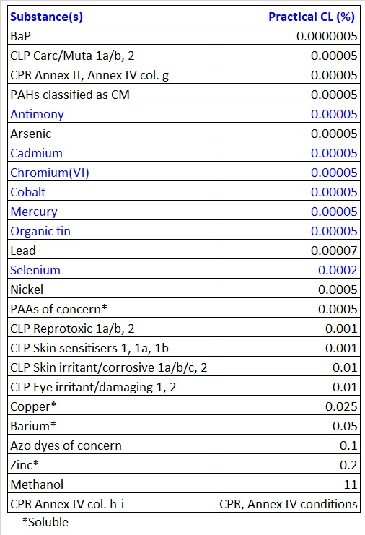

Slide 17
Colorants
19 colorants banned for use in hair colours are proposed to be banned by RAC and SEAC in tattoos inks.
Possibility for a transitional period for 2 colorants Pigment Blue (PB 15:3) and Pigments Green 7 (PG7)

Slide 18
Additional conditions
Transitional period of one year
Will allow sufficient time for actors in the supply chain to meet the proposed requirements as well as it will accelerate a full implementation of this restriction
Assuming that production of non-compliant inks will stop immediately after adoption of this restriction, 12 months is sufficient for the industry to comply

Slide 19
Additional conditions
Colourants in Annex IV of CPR with conditions on their use
Onus on tattoo artists/practitioners to ensure that compliant inks are used for tattooing procedures
Onus on who places tattoos inks on the market to provide specific labelling on the ink products produced and imported in EU
Restriction proposal provides clear definitions of tattoo and PMU procedures, which are a prerequisite for enforcement

Slide 20
Other measures
Hygienic requirements, registration, certification, training → not in the scope, but under national jurisdiction
Obligatory informed consent → not in the scope, but could be introduced under national jurisdiction
Under national legislations based on CoE ResAPs systems are in place to monitor compliance and to share information on enforcement actions on dangerous products (RAPEX)

Slide 21
Comments received from the public consultation
MSCA, NGOs
the issue of cumulative effects of hazardous substances in tattoo inks
endocrine disruptor properties relevant for the restriction
issues related to analytical methods
review clause and “positive list” recommended (also by Ind and individuals)
data on analysed tattoo inks provided…
Industry
longer transition period required (up to 5 years) with justification
CLs for Cr(VI) and Pb in carbon black too low → no enough data for evaluation
restriction which does not regulate risks not related to chemicals will not be efficient enough → support for a stand-alone regulation
concern that EU manufacturers will not be able to comply with the restriction - non-compliant products will be illegally present on the market…
Academic institution, individuals
support for a stand-alone regulation
concern about health risks of derogated pigments
importance of training and licensing…

Slide 22
Uncertainties
Exposure, hazard and risk assessment for intradermal exposure inadequately explored
Intradermal route considered whenever possible (i.e. for skin irritants)
Correction factor for oral absorption applied where relevant (Cu, Ba)
Exposure scenario: realistic worst case (amount of tattoo ink injected) or worst case (complete bioavailability of injected tattoo inks for full-coloured full-body tattoo) → risk overestimation
Unknown decomposition products of tattoo colourants in the skin → skin metabolism, sun exposure, tattoo removal (e.g. laser)
Pigments as nanoparticles
Unknown alternatives, health risk inadequately explored
Available data insufficient to assess
Restriction’s reviews important!
Uncertainties in epidemiological data
Non-existent or not standardised analytical methods
EU-harmonised diagnostic codes for tattoo-related adverse effects
Practical CLs expected to promote development
EU project on analytical methods

Slide 23
ECHA Committees are of the opinion that these uncertainties do not present obstacles for implementation of the proposed restriction
On the contrary, this restriction could be an important initiative for the scientific community to fill above stated knowledge gaps
Although popularity of tattooing began to increase more than a decade ago, there is a significant lack of data on toxicokinetics, hazards and risks of intradermally injected chemicals!

Slide 24
Timeline of the full procedure
RAC opinion adopted 20 November 2018
SEAC opinion adopted on 14 March 2019
Trasmission of the two opinions to the EU Commission by mid of April
EU Commission has 3 months to preparare the Regulation to amend Annex XVII to REACH
The Regulation will be voted by Member States with the scrutiny of the EU Parliament and the Council (3 months)
After the 3 months, the Regulation will be published in the OJ and will enter into effect after 12 months

Slide 25
THANK YOU !!!
https://echa.europa.eu/previous-consultations-on-restriction-proposals

