Slide 1
Tattoos and Psoriasis; Embracing One Stigma to Conquer Another
How individuals suffering from Psoriasis, utilize tattoos as a catalyst to reclaim and anchor their self-identity
Presentation by Mads Wedel Kristensen (Copenhagen, Denmark) Cand. Scient. Soc. / Embodiment Sociologist

Slide 2
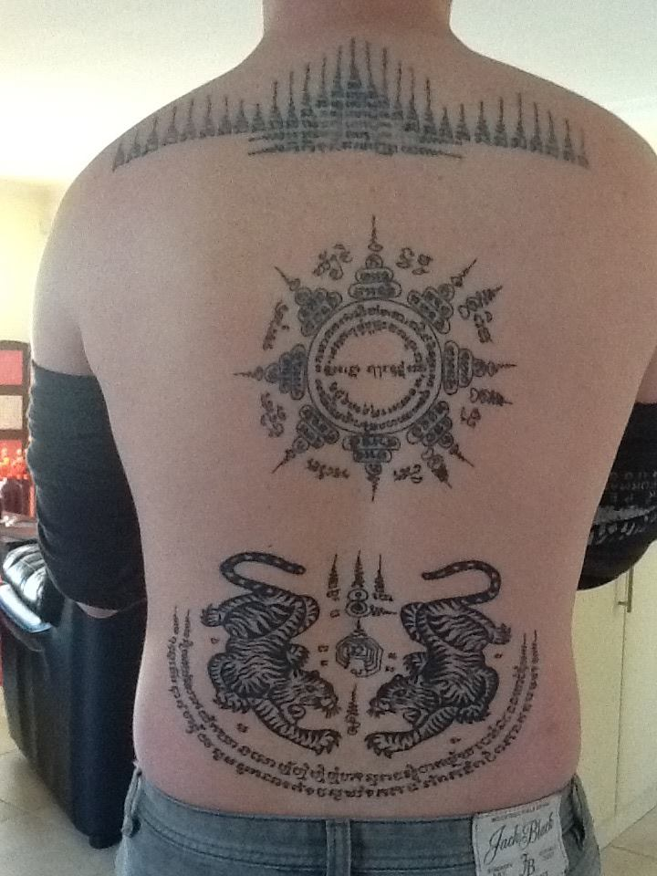
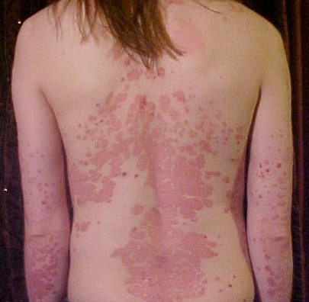
Why Tattoos and Psoriasis:
New perspective on body-image
Allows investigation into 2 forms of stigma – simultaneously
New perspective and more intimate look at stigma and the body

Slide 3
Stigma and Embodied Identity
Forced/born into, Stigma.
Voluntary/ Freely Entered into, Stigma.
Body image and stigma.
Feeling Anomie in regard to your own body.

Slide 4
Reclaiming the body:
The importance of body image.
Illness, chronic conditions and discrimination = Feeling of lost agency over ones body
Tattoos as a way of reclaiming your embodied identity

Slide 5
Conclusion
Tattoos are not something to advice against, when they are done right.
Tattoos can have a positive effect on body-image and self-perception
Tattoos have a higher personal importance than ever before
One stigma does not replace the other – but it can help!

